Slide 1
PA4 File Encoding
Create a menu driven system that will give the user an option to:
Encode a file
Decode a file
Word Count
Exit the system

Slide 2
Encode a File
The system should prompt the user for the file name to encode
Encoding should be done using a ROT-13 algorithm
Only characters (A – Z) should be encoded.
The system should prompt the user for the file name to store the encoded file

Slide 3
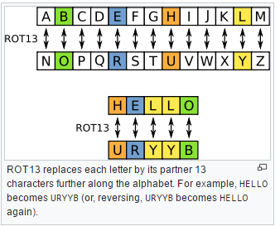
Example ROT System
* Source Wkipedia.com

Slide 4
Decode a File
The system should prompt the user for the file name to decode
Decoding should be done using a ROT-13 algorithm
Only characters (A – Z) should be decoded.
The system should prompt the user for the file name to store the decoded file

Slide 5
Word Count a File
The system should prompt the user for the file name
Count the total number of words in the file
Display the word count to the user on the console

Slide 6
Grading – Worth 100 Points
Deliverable | Amount
Encoding | 30
Decoding | 30
Word Count | 20
Menu / Flow of Control | 10
Efficient, well structured, properly commented code | 10
We will not be counting “extras” in this project
Due 4/3 at 2:00pm
Github Assignment Link: https://classroom.github.com/a/mLh4AGsJ

